Slide 1

Fake Currency Detection Using Deep Learning
by
M.Suhas
Roll No. 184G1A05A0
J.Vinay
Roll No. 184G1A05B4
K. Ruchitha
Roll No. 184G1A0566
G.Sai Subramanyam
Roll No. 174G1A0573
Under the guidance of
Mr. K.Lokeshnath M.Tech.
Assistant Professor
Department of Computer Science and Engineering
Srinivasa Ramanujan Institute of Technology
(Affiliated to JNTUA & Approved by AICTE) (Accredited by NAAC with ‘A’ Grade & Accredited by NBA (EEE, ECE & CSE)
Rotarypuram Village, B K Samudram Mandal, Ananthapuramu – 515701.
2021 - 2022

Slide 2
Abstract
Great technological advancement in printing and scanning industry made counterfeiting problem to grow more vigorously. As a result, counterfeit currency affects the economy and reduces the value of original money. Thus it is most needed to detect the fake currency. Most of the former methods are based on hardware and image processing techniques. Finding counterfeit currencies with these methods is less efficient and time consuming. To overcome the above problem, we have proposed the detection of counterfeit currency using a deep convolution neural network. Our work identifies the fake currency by examining the currency images.The proposed approach efficiently identifies the forgery currencies with less time consumption.

Slide 3
Contents
Abstract
Introduction
Existing System
Proposed System
Literature Survey
Problem Definition
Planning
Requirements
UML Diagrams
Conclusion
References

Slide 4
Introduction
In recent years a lot of fake currency note is being printed which have caused great loss and damage towards society. So, it has become a necessity to develop a tool to detect fake currency. This project proposes an approach that will detect fake currency note being circulated in our country by using their image. Our project will provide required mobility and compatibility to most peoples as well as credible accuracy for the fake currency detection. We are using Convolutional Neural Network to detect the fake currency.

Slide 5
Existing System
In the Existing System, it takes input as the image only through the scanner and it only scans the front part of the currency note.
In the existing System it only processes the images by using the image processing techniques .
The recognition of patterns doesn’t take place by the image processing.
Due to the different sizes and patterns of notes the image processing techniques cannot detect the fake notes efficiently and gives low accuracy rate.
The Existing System takes lots of time to scan each and every note manually and not efficiently detect the currency.
It takes more time to detect the fake currency note.

Slide 6
Proposed System
In the proposed system, we take the scanned images as a input from the folder which contains the scanned images of both fake and original images.
We can use this is in AI robots and in this we can also use CNN , SVM algorithms.
By using CNN algorithm the currency notes are trained .
By using SVM algorithm we can classify the notes as fake or real.
The Scanned image is compared with the image from the dataset then a matrix is formed for the scanned image.
The dataset contains the original images of currency notes each original note contains the matrix.
If the scanned image matrix and the dataset image matrix is same then it is a original currency note otherwise it is a fake currency note.

Slide 7
Literature Survey
[Sawant et al. [5]] used image processing techniques and minimum distance classifier techniques of scanned currency images. The research used stand color extraction, segmentation, feature extraction using Fourier Descriptors and identification of the shapes through the extraction of the unique identification marks and latent image numbers using the Minimum Distance Classifier. The method reported accuracy close to 90%.
[Manikandan [6]] proposed a currency recognition system for mobile application for visually challenged people based on currency localization techniques. The study used the Matlab image processing toolbox libraries. The system captured images with the mobile camera and uses morphological techniques, to identify the different currency notes. The currency recognition system provided an accuracy of 93% based on a data set of 165 images.

Slide 8
Problem Definition
The Existing System, doesn’t scanned the rear part of the currency note it only scans the front end part of the currency note.
The existing system doesn’t give efficient results and it’s accuracy rate is low.
Image processing and pattern recognition area is the base area for feature extraction.
Existing system is a time consuming process for detection.
There are some techniques which are specifically from the application area of Image processing and pattern recognition and using those techniques the researchers achieved the accuracy rate low.

Slide 9
Planning
WEEKS | TASK
Week 1 | Downloading and Installing Softwares, Collecting the required information
Week 2 | Designing and implementing the Front End
Week 3 | Implementing the Back End
Week 4 | Coding and Integration
Week 5 | Testing the Application

Slide 10
Requirements :
Hardware Requirements
I3 Processor : P-IV
Memory : 2GB RAM(Min)
Hard Drive : 40GB
Monitor : SVGA 21
Software Requirements
Operating System : Windows 7 Ultimate or higher
Tools : Pycharm
Languages Used : Python
Library : Keras, Numpy, Scipy, Scikit, Tensorflow,Tkinter, Matplotlib, Sklearn
Front end : Django
Back end : Python

Slide 11
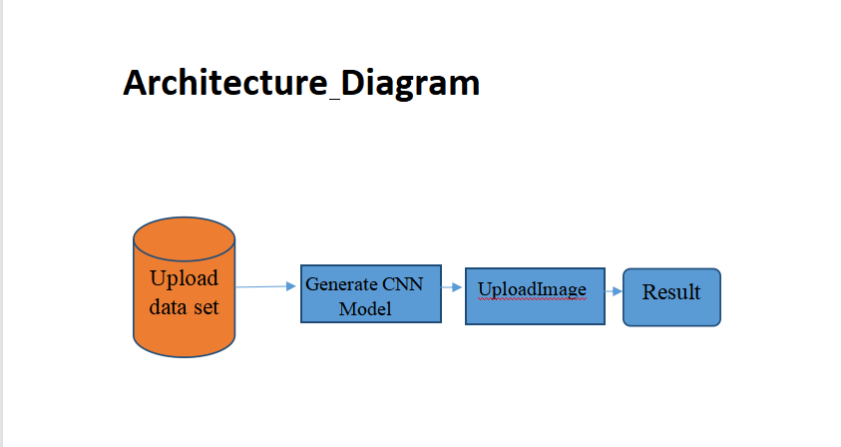
Architecture
Fig : Architecture of Fake Currency Detection

Slide 12
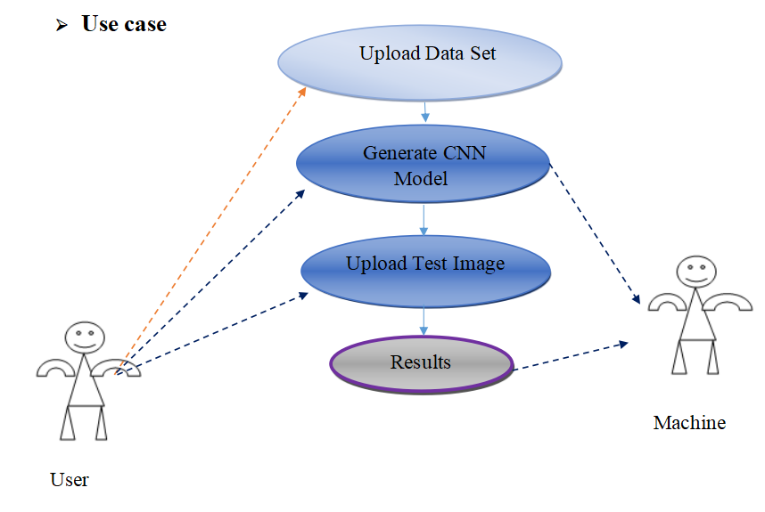
Use Case Diagram
Fig :Use Case Diagram For Fake Currency Detection

Slide 13
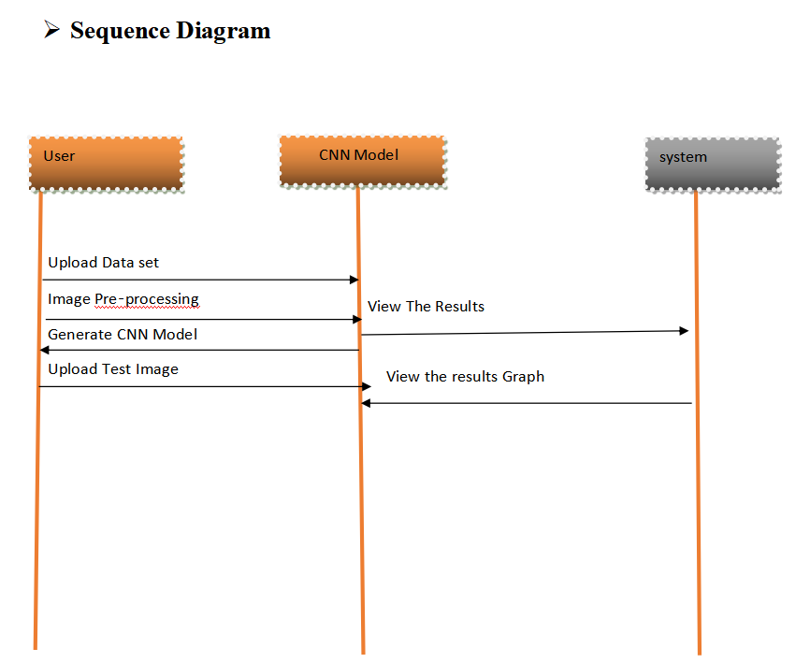
Sequence Diagram
Fig :Sequence Diagram for Fake Currency Detection

Slide 14
Implementation
The very first step in this is, Uploading the datset, that contains the scanned images of real images.
By using CNN algorithm the dataset will be trained.
Next is to Generate CNN Model, it gives accuracy of the CNN trained data model.
Upload test image is last step in this we upload the image as input , the images are already scanned and stored in a folder.
The folder contains both Fake and Real images, by selecting the any image from it, it will detect the real and fake image.
CNN alagorithm train the dataset and produce as a matrix, each note as single matrix.

Slide 15
Contd...
The each input image is also coverted into matrix by CNN.
When we upload the test image it will compare input image matrix and the dataset image if both the matrices are same it will detect as Real otherwise Fake currency Note.
By implementing this we can detect fake currency with high accuracy and it takes less time to detect.

Slide 16
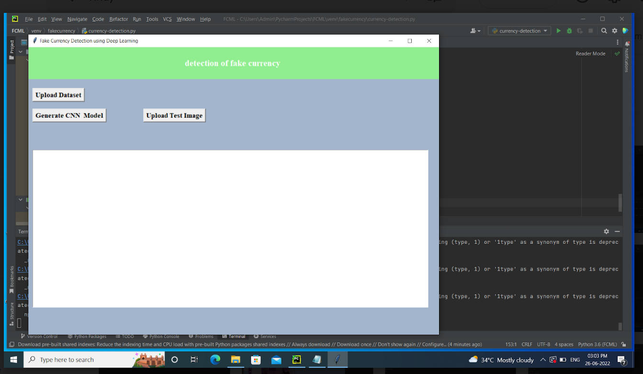
Execution Results
The displayed page, is page where used to detect the currency notes on the screen it contains three buttons namely, upload the dataset, generate CNN model,upload test imgaes

Slide 17
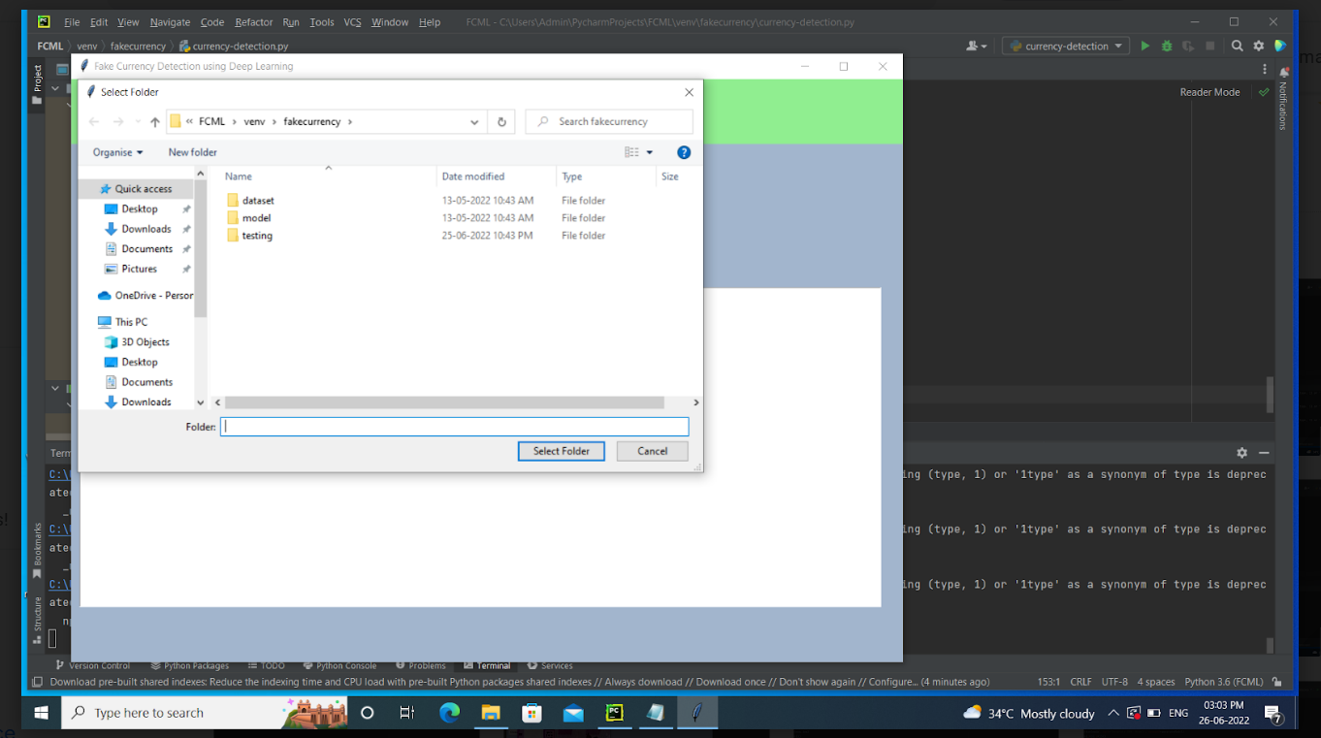
Uploading the dataset
When we click on the upload dataset button it redirect to the folders where our dataset resides in that select the
folder which contains the dataset by clicking on the selected folder

Slide 18
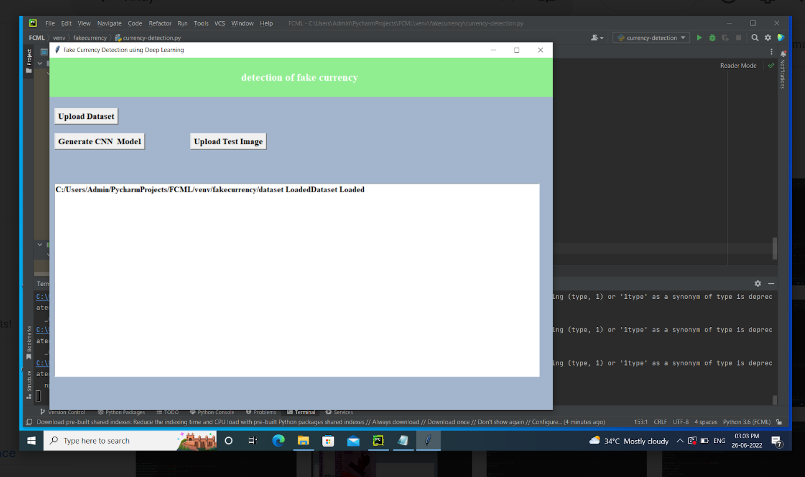
Data Set Loaded
The data set is loaded and it shows the path of dataset

Slide 19
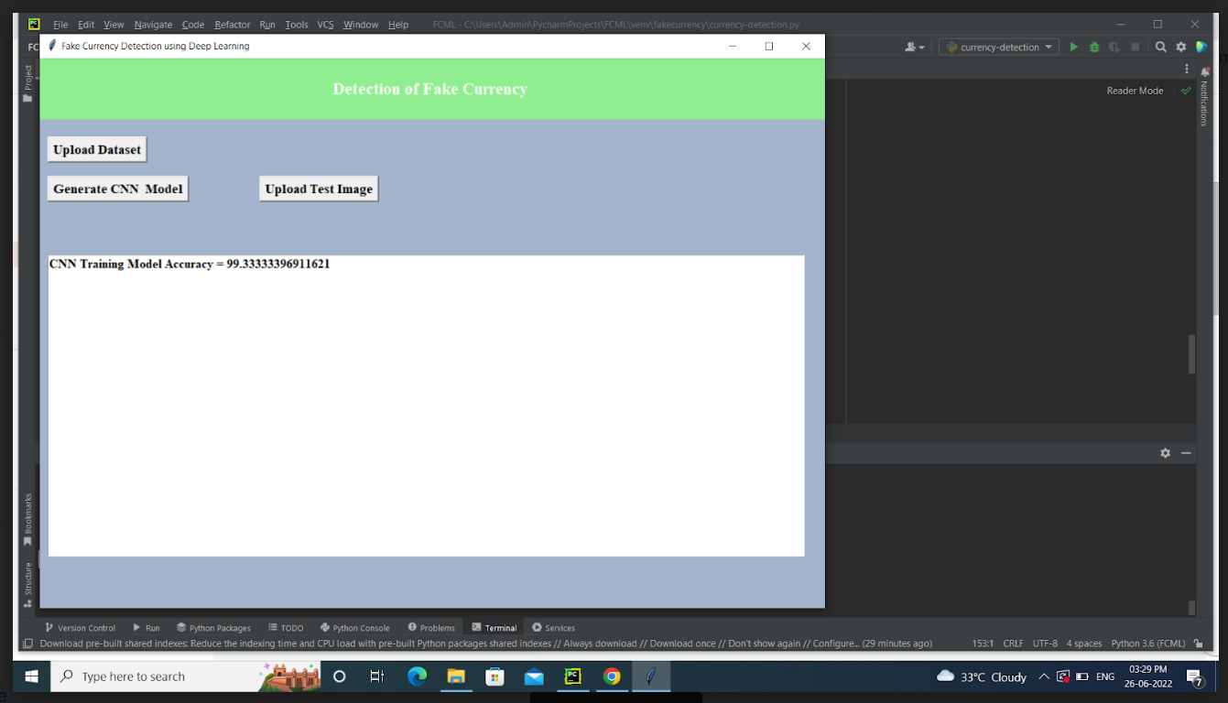
Generate CNN Model
By clicking on the CNN model we get the CNN training model accuracy

Slide 20
Upload Test Image
When we click on the upload test image it redirect to the folder where we contain the scanned images we can consider it as a input image.
The CNN Model will generate the matrix to the input image.
Trained dataset images from CNN model also contain the matrix from.
By comparing the trained image and input image currency note will detect.

Slide 21
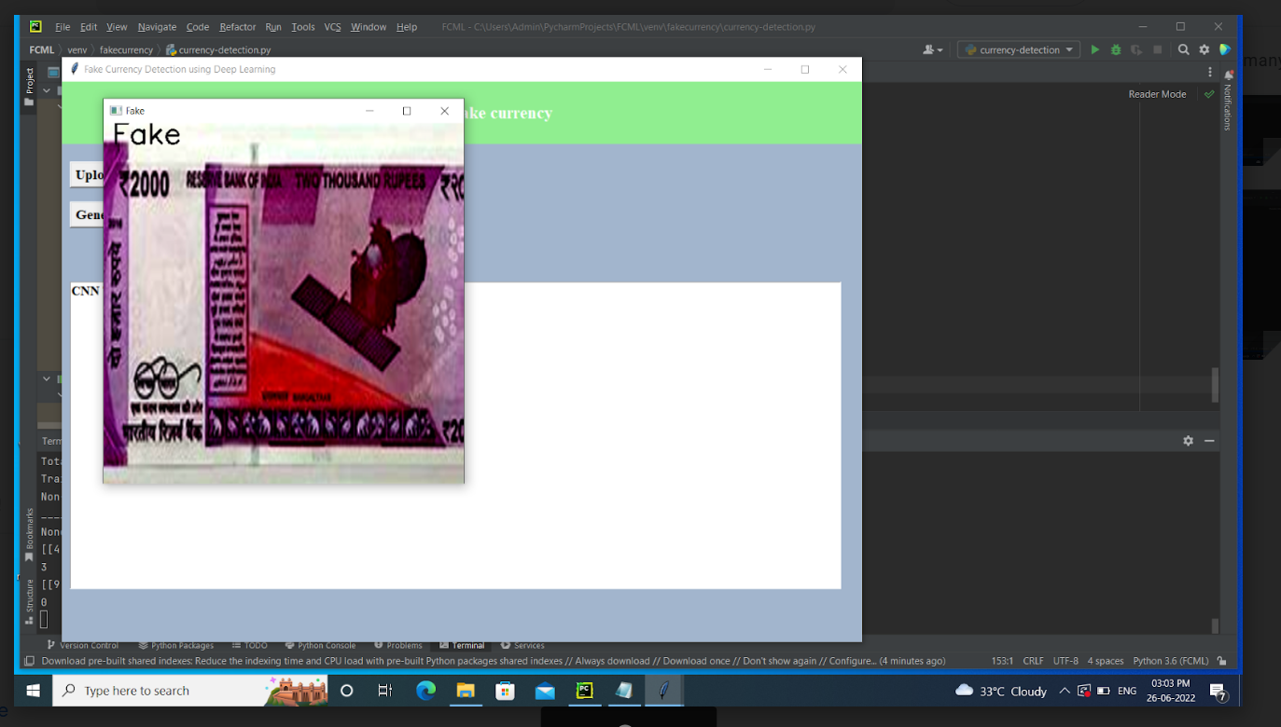
Detecting the Real and Fake Note
If the input image matrix and trained datset image matrix is not matched it shows the note is Fake

Slide 22
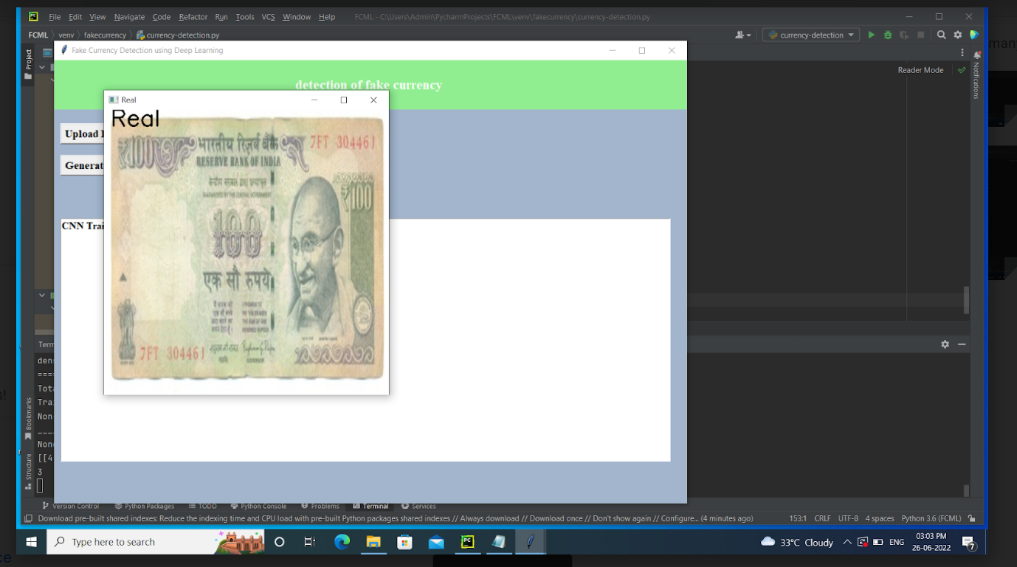
Contd...
If the input image matrix and trained datset image matrix is matched it shows the note is Real

Slide 23
Conclusion
Deep learning has gained tremendous success in image classification tasks. Our
architecture which is based on Deep CNN works as feature extractor eliminating
the need to apply image processing technique and manually checking the
presence of security features in the note. The generated dataset has successfully h
helped conduct experiments and tried to mimic the real-world scenario. The
application built will be useful to any common person to detect a counterfeit note.
Future scope includes trying out new Deep CNN architectures to increase the
accuracy the model. Increasing the data-set, so that the model gets trained better
and produce the better results.

Slide 24
Refernces
Journal Article
[1]. Tusher Agasti, Gajanan Burand, Prathik Wade and P Chitra “Fake Currency Detection Using Image Processing , School Of Electronics Engineering, VIT University, Vellore, Tamil Nadu,India.
Journal Article
[2]. Cesar G.Pachon, Dora M. Ballesteros and Diego Renza “Fake Bank Note Recognition using Deep Learning “of Engineering , Universidad Militar Nueva Granada , Bogota 110111, Colombia.

Slide 25
Thank You!!!

